Slide 1

Movie Analysis
1996-2016
Shilpi Ray
Becky Li
Alexis Fox
Bryce Dudka

Slide 2
DATA SOURCE
IMDB 5000 Movie Datset:
https://data.world/ansel/imdb-5000-movie-dataset/workspace/file?agentid=popculture&filename=movie_metadata.csv%2Fmovie_metadata.csv
Rotten Tomato Movie database:
https://www.kaggle.com/ayushkalla1/rotten-tomatoes-movie-database
TMDB 5000 Movie Dataset:
https://www.kaggle.com/tmdb/tmdb-movie-metadata/version/2#
IMDB Top 250 Directors:
https://www.imdb.com/list/ls008344500/

Slide 3
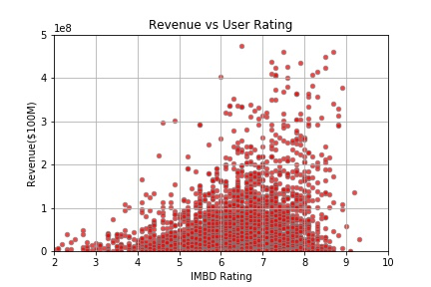
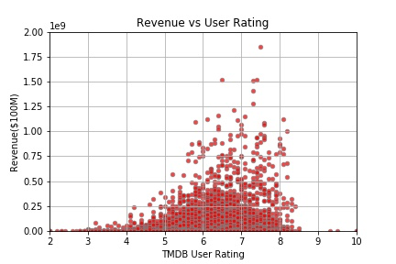
Revenue vs. Ratings- ANALYSIS

Slide 4
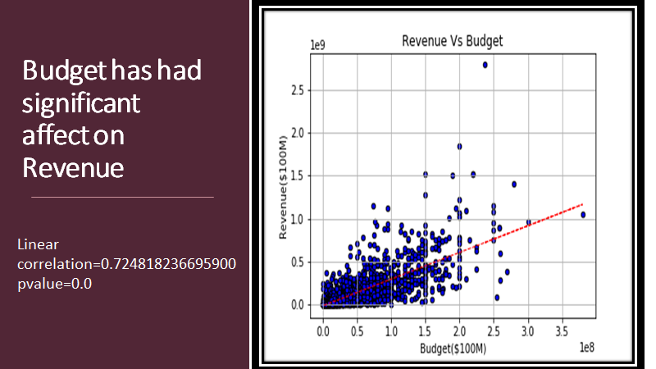
RAVENUE VS BUDGET

Slide 5
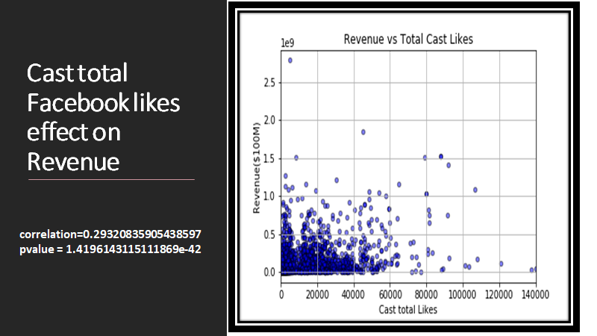

Slide 6
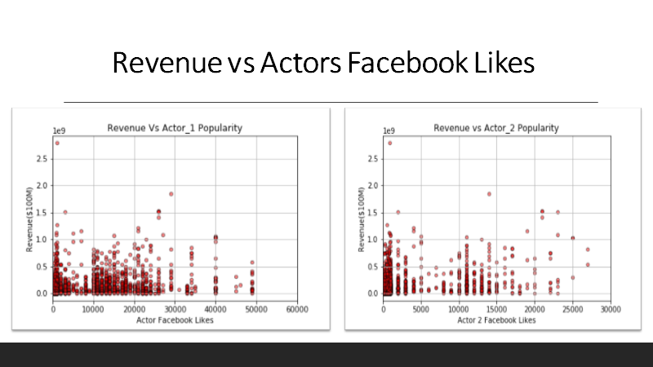

Slide 7
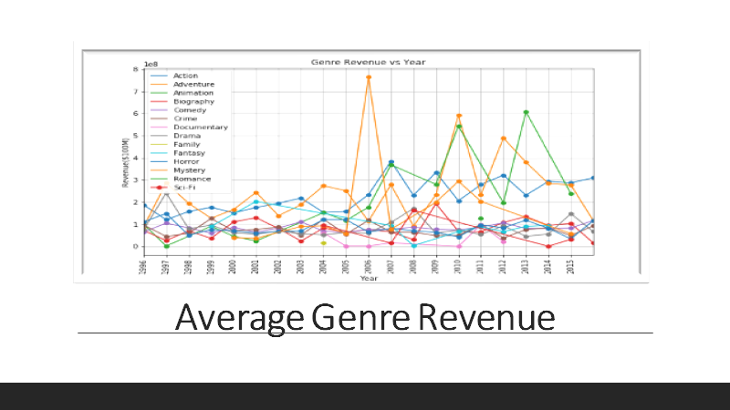

Slide 8
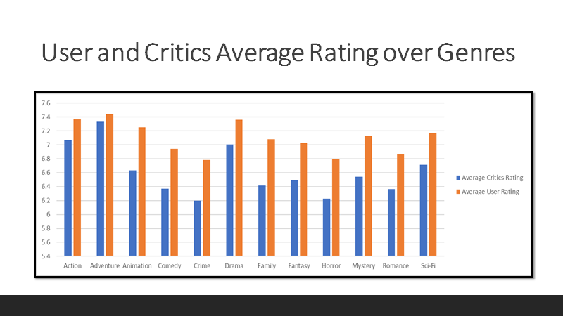

Slide 9
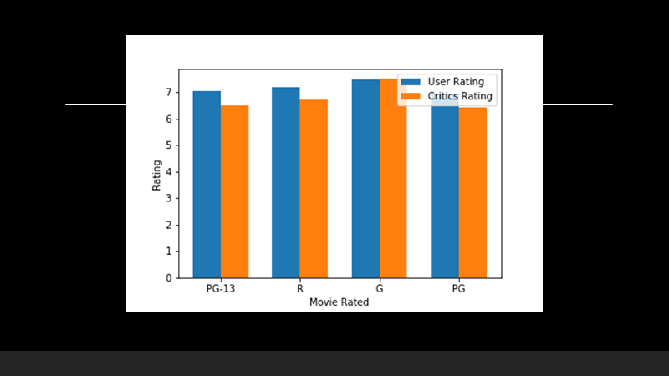

Slide 10
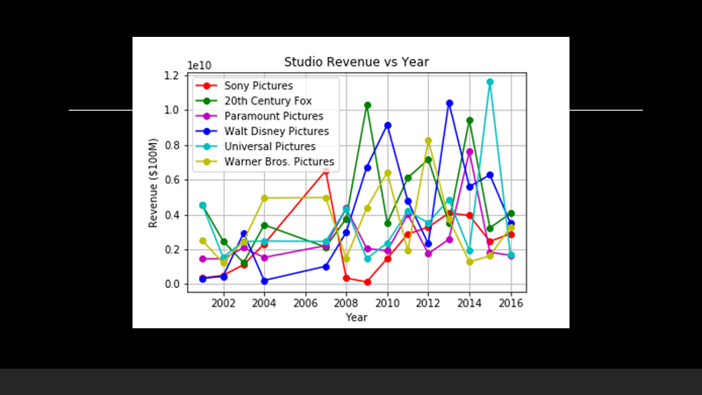

Slide 11
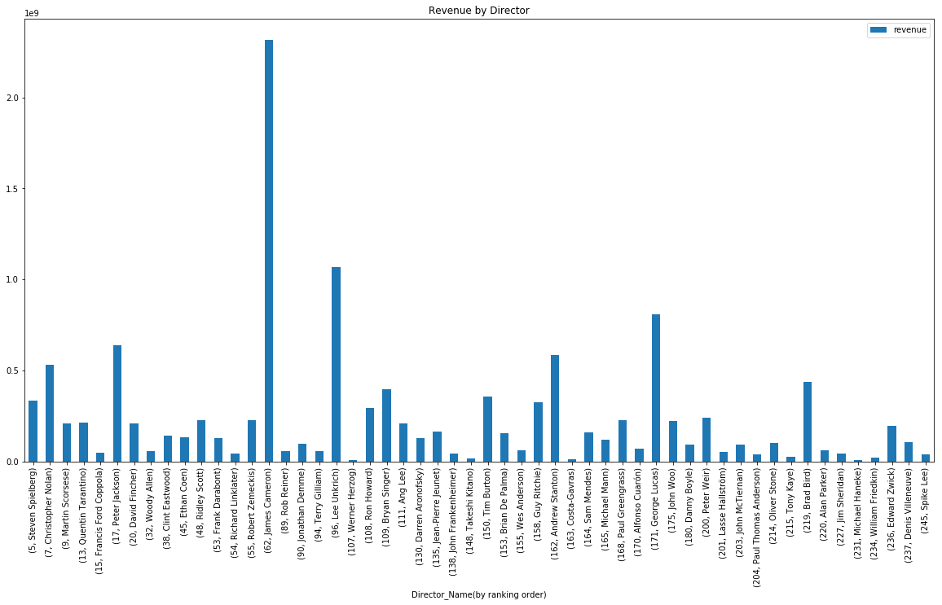
Revenue by Director

Slide 12
CONCLUSION
By comparing our data from 1996 to 2016 we found revenue vs. budget, and revenue vs. ratings to have significant correlations.
No correlation between director popularities and cast popularities on revenue.
Action, Adventure and Animation is the most popular genre.

Slide 13
DATA PROCESS
look up data

Slide 14
ISSUES ALONG THE WAY
Missing data, lot of zero values
Some data set had different named columns, extra columns
Not all data had all countries
Different years for each – all started in 1960 but ended in 2016, 2017, 2013, etc.
Non-linear data – (had to convert x-axis into log to gain insights on correlation)
DIRECTIONS WE COULD GO WITH MORE TIME
Add in more data sets by country – age, ethnicity, gender, education, family size etc.
Perform same analysis back to 1960
Perform analysis for key countries of interest
Create prediction model

Slide 15
Q&A
Example questions:
What is your favorite color?
Where are you from originally?

